Slide 1
Definite Integrals
I.I.S. Pellati Nizza Monferrato
5 Class - CAT
a.s. 2015/2016
th

Slide 2
Table of contents
1. Pre-requisite knowledge
2. Area of flat curved figures
3. Definite Integral of a function
4. Applications
5. Area between curves
5. Solids of revolution
6. Numerical Integration

Slide 3
1. Pre-requisite knowledge
Review of some basic concepts
The aim of the activities is to recover well-known topics and
to focus on micro maths language
Activity 1 (10 min.) Set, partition, sequence, domain to lift, length, range | Activity 2 (5 min.) Maximun, Minimum, Graph of a function, sequence, interval, partition

Slide 4
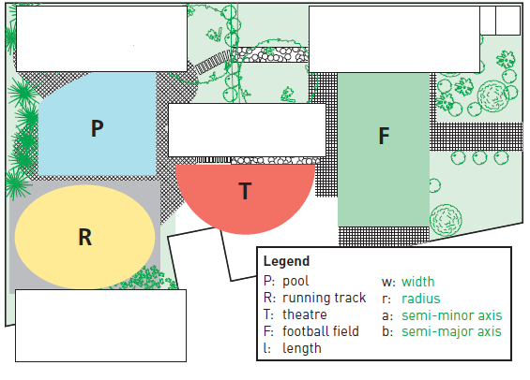
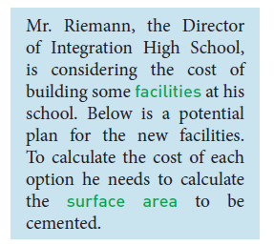
2. Area of flat curved figures
The activities of this section introduce the problem of the calculating areas of flat figures whose perimeter is a curved line.
An example is the area of a pool which has to be built in the school’s athletic field as shown

Slide 5

Use these formulas for calculating the areas or the statement to fill in the boxes in the figure above.
Note the legend below the figure, on the right.
A=lw A= A= A new kind of formula is needed
Complete ACTIVITY 3 (5 min.) reading, watching, selecting and writing. The aim is to strengthen the concepts of inscribed and circumscribed rectangles, the estimate of area
Listen to the audio-file and then complete ACTIVITY 4 (8 min.)

Slide 6
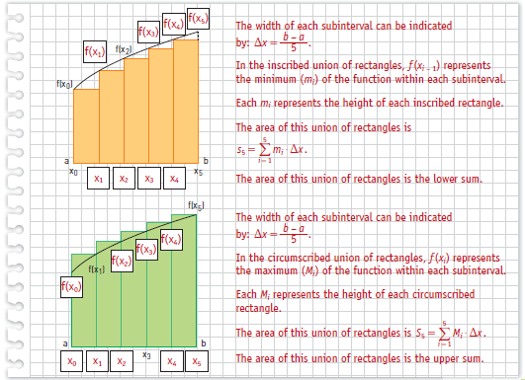
Toward the definition of Definite Integral
If the perimeter of the pool is considered like the graph of a function the problem becomes:
Lower sum
Upper sum
Activity 5. aim: to gain familiarity with the lower and upper sums
Activity 6
Use the correct words to complete the text
Activity 7
Self assessment

Slide 7

3. Definite Integral of a function f(x)
Definition
Let’s indicate the P area with the letter S to adapt it to the maths language of most texts. Then:
s_{n} < S < S_{n}
If the number n tends towards infinity, and the width of each interval tends toward zero, then the limit of the two sequences tends towards the same limit:
This limit is called definite integral of the continuous function f(x) in the interval [a, b].

Slide 8
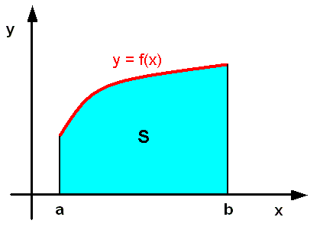

Geometric meaning
The integral of a positive and continuous function in an interval [a, b] is the number that represents the area delimited by the graph of the function f(x), the x-axis and the two vertical lines of equation x=a and x=b.
The origin of the Integral symbol
(from Wikipedia)

Slide 9
4. Applications
The definite integrals find many applications in various fields and subjects from physics to geometry, to electrical engineering and dynamics.
In geometry two applications are very important:
the area between curves
The volume of solids generated by rotating a curved figure around an axis

Slide 10
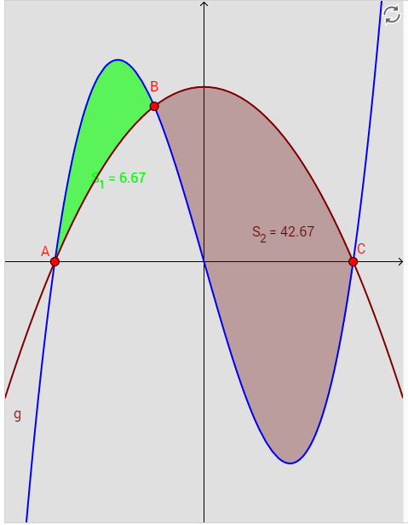
5. Area between curves
Rules
_{Activity 8.}
The following videos show how to calculate the area
between curves. Look at the videos.
Find the differences in the two videos below
video 1 (area between curves) Transcript
Quiz
video 2 (area with multiple boundaries)
Task: create a Transcript of video 2

Slide 11
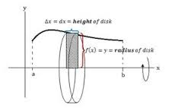
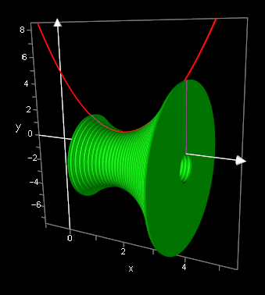


6. Solids of revolution
Definition and how to calculate the volume
Look at video 3
1. create a transcript of the video
2. calculate the volume of the solid obtained by rotating the section delimited by the function in the interval around the x-axis.

Slide 12
7. Numerical Integration
Not all functions admit an antiderivative in an explicit form
The antiderivative of a function can be hard to calculate
The function is given only in a set of points
For these reasons it is necessary to introduce another process to integrate: the Numerical Integration
What is Numerical Integration?
How many methods does it incorporate?
What are these methods?

Slide 13
Final Task:
Create a presentation to show your research work and implement a computer program by Excel, or similar tools, to use one of these methods to calculate a numerical integral
attached below is an example of teamwork carried out by my students: presentation and computer-program

Slide 14
Sitography and bibliography
https://www.khanacademy.org/math
https://en.wikipedia.org/
https://www.mathsisfun.com/
https://my.zanichelli.it/
www.intmath.com
www.originlab.com
Elementi di analisi e complementi di matematica. R. Palatini – N. Dodero

